Slide 1
Migration, integration
Åland
17 November 2017
Siv Ekström
Rektor, Medborgarinstitutet i Mariehamn

Slide 3
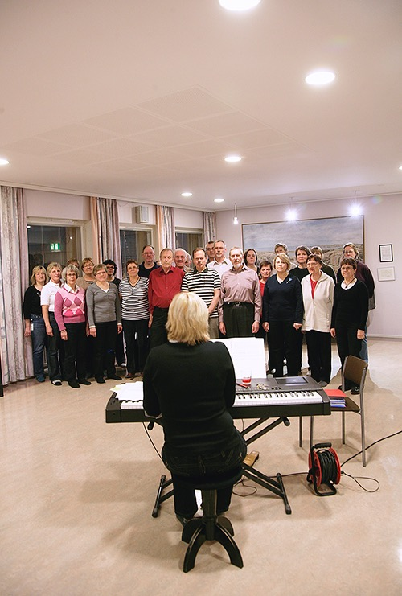

Slide 9
Sfi -
Swedish for immigrants
Intensive courses in Swedish for immigrants
A labor market training scheme
The courses are funded by Åland governement
Free of charge for students
Students receive support from Ams during courses

Slide 10
Admission requirements:
a resident on Åland
covered by the Finnish social system (FPA)
registered as a job seeker at AMS (the Åland Job Centre)
able to read and write the latin alphabet

Slide 11
The Common European Framework of Reference for Languages: Learning, Teaching, Assessment (CEFR)
Three levels, each divided in two: A, B, C
A1, A2 and B1 are the levels offered in the courses the Åland government orders from Medis.

Slide 12
CEFR

Slide 13
Lessons
08.30-15.15 every day
A1 - 10 weeks (350 lessons),
A2 and B1 - 20 weeks each - (700 lessons).

Slide 16
Practical placement
Internship - schools, daycare, shops,
At level A2 - 3 weeks
At level B1 - 4 weeks

Slide 18
Different alphabets or no reading skills
Courses for students with different alphabets or without reading skills.
The students study from 9.00 until 14.00 five days a week. Maximum 10 students.

Slide 21
Svenska i arbete
Swedish for employees
Short courses for employees
50% during work time
50% efter work
Free of charge

Slide 22
Refugees
Some of the municipalities on Åland have agreed to welcome refugees from UNHCR:s resettlement program. Since 2015 Mariehamn, Jomala, Sund, Saltvik, Brändö and Kumlinge have received a total of almost 50 Syrian refugees. The courses in Swedish for these refugees have also been a task for Medis.

Slide 23
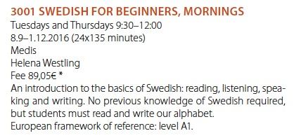
Ordinary Medis courses
Swedish courses in Medis´ normal program
A couple of lessons one or two evenings every week. The students have to pay a fee and buy their own books.

Slide 24
The Finnish National Certificates of Language Proficiency
language proficiency tests intended for adults.
assess language skills in practical situations where adults may generally need to speak, listen, write or read in a foreign language – at home or abroad.
Medis local organizer in Åland

Slide 25
Certificate
to demonstrate language proficiency in a job application
to demonstrate language proficiency required for work assignments
as part of your studies
to demonstrate language proficiency required for acquisition of Finnish citizenship.

Slide 26
Flex-In
European Social Fund
produces online material for studying Swedish.
creates a variety of web based exercises, plus texts, films and recordings with information about Åland and Finland.
one group lesson with a teacher every week & students are required to study at home on line in between the lessons.

Slide 27
integration.ax
2010-2013

Slide 28
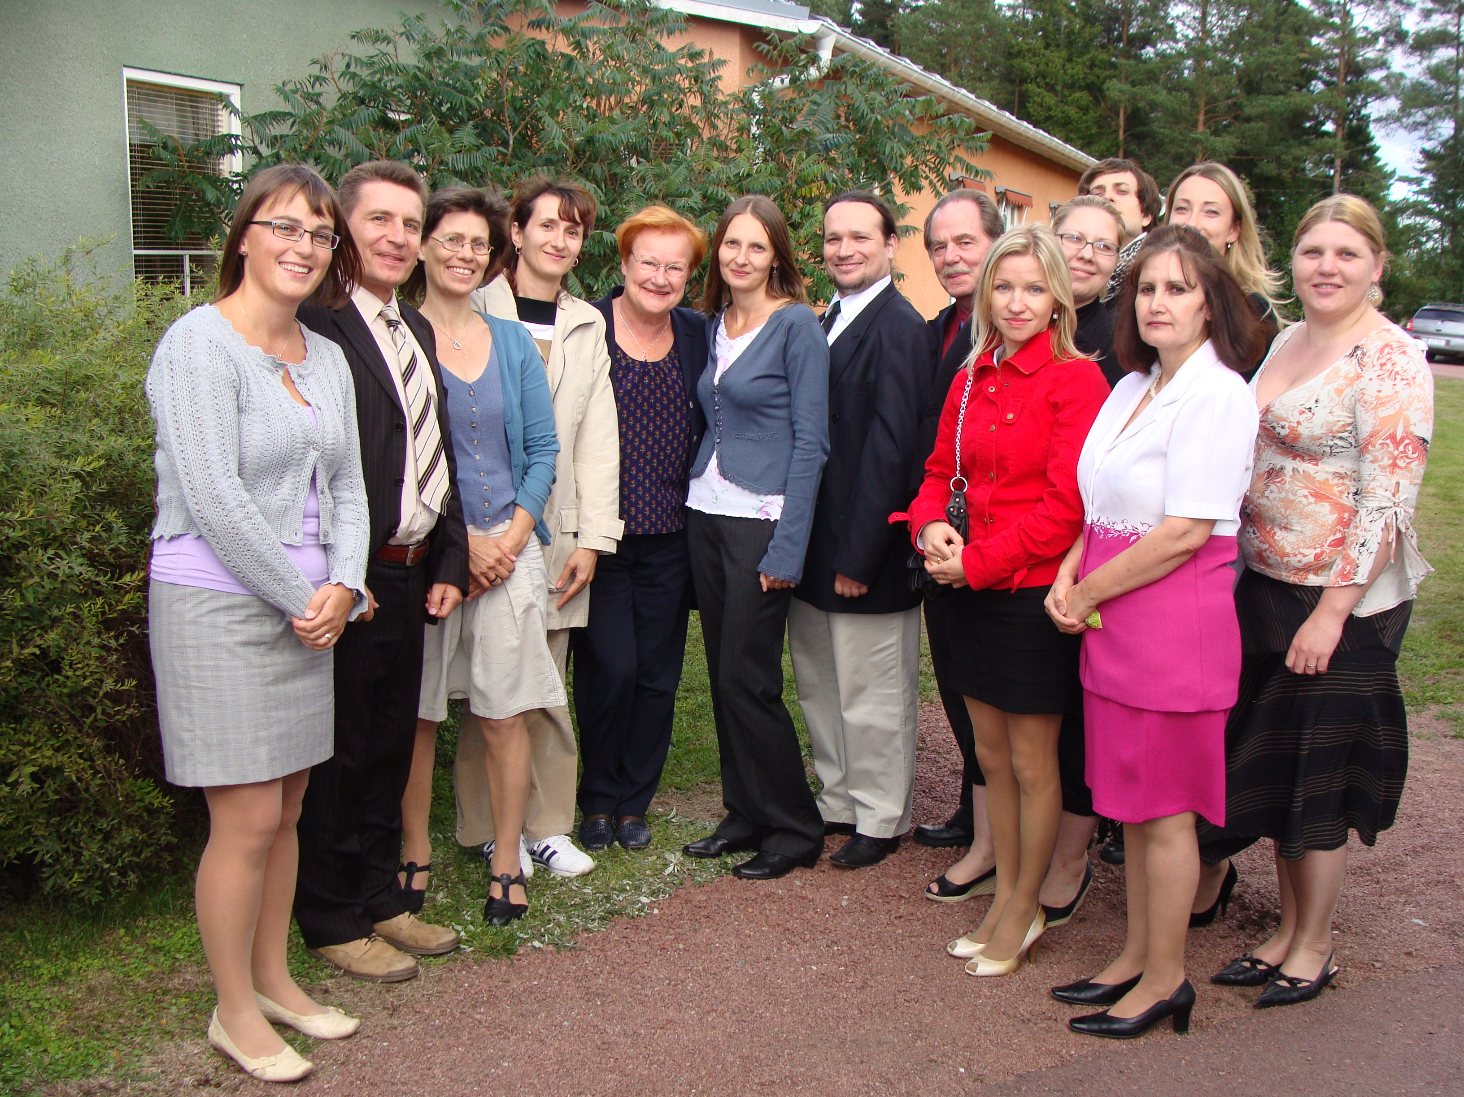

Slide 29
Information office for immigrants
Owner: The Åland Government
Open Tuesdays and Thursdays 13-16
Advice and assistance
Events, information, lectures

Slide 30
Events
Restaurant Day (http://www.restaurantday.org/en/)
Bus tours
United invitations (http://www.unitedinvitations.org)
Information talks (Start your own business, Your rights and duties as an employee)

