Slide 1
Presentation of rapporteurship on cultural affairs
BSPC Standing Committee meeting, 16-17th of November 2017, Mariehamn Karin Gaardsted, Denmark

Slide 2
E-sports in the Baltic Sea Region
Notes:
As the new rapporteur on cultural affairs I have chosen to focus my work on e-sports

Slide 3
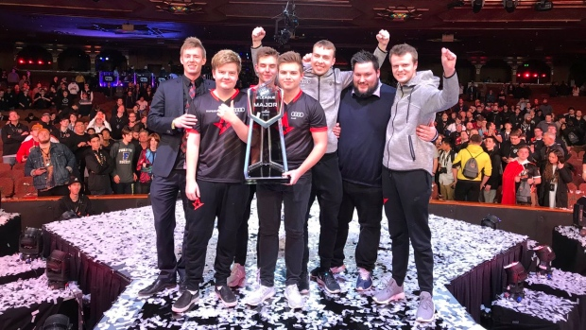
What is e-sport?
Definition:
“Esports is the compound word from “Electronic” and “Sports”, and is a general term to describe a competitive sport performed by using IT & Communication technologies such as PC, Display Equipment, Network and other electronic devices” (International e-Sport Federation)
→ Competetive gaming
The world’s fastest-growing sport
Expected revenue in 2017: 696 million dollars
Notes:
E-sport is the fastest growing sport –in terms of players, teams, viewers as well as revenue

Slide 4
Young people and e-sport
Global audience = 385 million people
Half the group aged 21-35
E-sports makes online and intercultural communication and meet-ups possible
Notes:
E-sports is especially popular among young people
The professional teams play in big arenas with 10.000 visitors and millions of viewers online
An example: At the IEM World Championship in Katowixc, Poland in march 2017, 173.000 people from all over the world visited the stadium event and the surrounding e-sports festival → e-sports gather people from different cultures
Due to the rapidly growing world of esports and its popularity among young people, the International Olympic Committe (IOC), has shown interest in the sport.

Slide 5
Challenges
Still not recognized or accepted on the same level as more ”traditional” sports like soccer or tennis
Associated with lazy teenagers in dark basements
73 % of the players and viewers are male
Notes:
All though e-sports is booming, it stills lacks acceptance and acknowledgement from ”the broader society”. Many people associate computer gaming with lazy teenagers in dark basements who sleeps in and neglects school.
E-sport is mainly played by young boys and men and not many girls play. Maybe it is a lack of interest but perhaps it is even less accepted among girls
It might be

Slide 6
Why e-sport?
Skills: concentration, team-work, ability to react fast, a strategic mind-set and much more.
Example from Denmark: Boarding schools creating special school courses with e-sports as main subject.
→ Attracting young people to continue in school
Notes:
E-sports takes concentration, response capability and a strategic and forward-thinking mind.
In Denmark several boarding schools have created special courses in e-sports with huge succes
It helps attract those students that might be tired of only having regular courses.
By becoming a more respected and accepted form of sports and integrating e-sports in schools and high schools, it is possible that e-sports might help attract those young people that might not would have taken an education otherwise.

Slide 7
Next-up
Blast Pro Series in Copenhagen on November 25th
Meetings with young players and talents
Meetings with event-makers and organizers of tournaments
→ What does the sport need?
→ How can the sport be developed?
The whole world is looking at e-sports right now – and so should we in the BSR!
Notes:
I would like to talk to the different stakeholders in the e-sports world
Goals: To get knowledge and inputs on what the sport needs
The whole world is looking at e-sports right now – and so should we in the BSR!

Slide 8
Thank you!

